Slide 1
Final Presentation
Reading Comprehension &
Quiz Generation System
Final Project Report — AI Lab
Mehdi
Roll No: 23i0048
Fahad
Roll No: 23i0614
1 / 16
scikit-learn | CPU-only | RACE Dataset

Slide 2
Presentation Agenda
What we'll cover today
01
Dataset — RACE Overview & Statistics
06
Model Training Process
02
EDA — Exploratory Data Analysis
07
Model Testing & Evaluation Results
03
Statistical Analysis & Interpretation
08
Performance Metrics & Interpretation
04
Data Preprocessing Pipeline
09
Live Demo
05
Model Selection Rationale
2 / 16
Mehdi (23i0048) | Fahad (23i0614)

Slide 3
Dataset — RACE Overview
ReAding Comprehension from Examinations
87,866
~70K
~300
questions
rows
words
Total Questions
Training Samples
Avg Article Length
Split | Rows | Articles | Avg Q Len | Balance
Train | ~70,000 | ~27,000 | ~11 words | ~25% each
Val | ~4,900 | ~1,900 | ~11 words | ~25% each
Test | ~4,900 | ~1,900 | ~11 words | ~25% each
3 / 16
Mehdi (23i0048) | Fahad (23i0614)

Slide 4
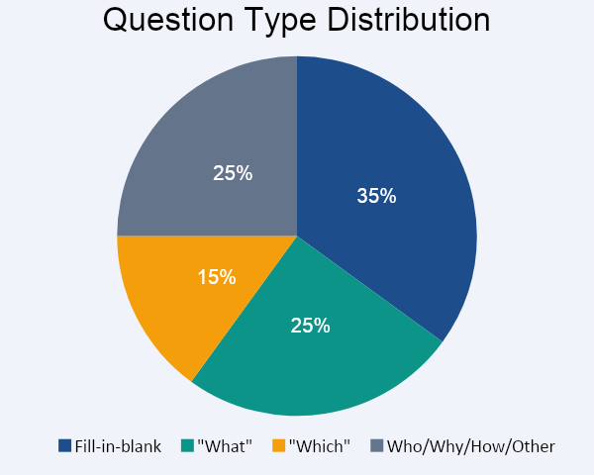
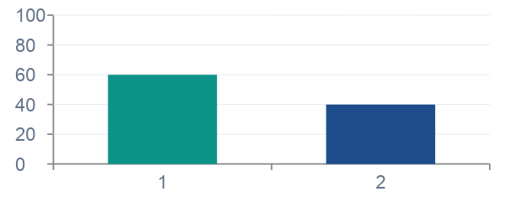
Exploratory Data Analysis
Understanding the data before modeling
Difficulty Split
Key EDA Findings
Article length: right-skewed (median ~250 words, max >1,000)
Answer labels (A/B/C/D) balanced at ~25% each — random baseline = 25%
Passages require multi-sentence reasoning — not simple span extraction
4 / 16
Mehdi (23i0048) | Fahad (23i0614)

Slide 5
Statistical Analysis Used
Methods applied throughout the project
📊 TF-IDF & CountVectorizer
📐 Cosine Similarity
One-Hot binary encoding (top-5,000 tokens) for sparse text representation. Evaluated TF-IDF — discarded due to IDF penalising important question words.
Measures angle between article and option vectors. Used as a key feature for answer verification and diversity penalty in distractor selection.
🔍 K-Means Clustering
🌐 Label Propagation (Semi-Supervised)
Silhouette score 0.0947 (weak separation — expected for high-dim text). Purity 0.7469 confirms 74.7% of items cluster with their correct class.
Graph-based manifold learning on unlabeled RACE corpus. Result: ~0.25 (near-random) — unlabeled data adds limited signal in this high-dim space.
5 / 16
Mehdi (23i0048) | Fahad (23i0614)

Slide 6
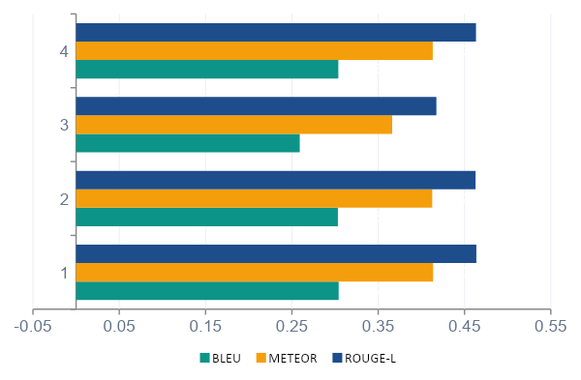
Statistical Analysis — Results Interpretation
Interpretation
LR tops every metric — high-dim sparse space favours linear models
SVM is very close (BLEU gap: 0.0009) — calibration adds noise
RF underperforms — restricted to 5 lexical features, hard ceiling
Ensemble slightly below LR — RF noise dilutes gains when included
K-Means purity 0.7469 validates that feature space has discriminative structure
Label Propagation at ~0.25 shows unlabeled data unhelpful here
6 / 16
Mehdi (23i0048) | Fahad (23i0614)

Slide 7
Data Preprocessing Pipeline
From raw text to model-ready features
1
2
3
4
Text Cleaning
Tokenization
Feature Engineering
Binary Labelling
Lowercase, strip punctuation
_clean_for_eval() ensures symmetry
between prediction & reference
CountVectorizer tokenises
top-5,000 tokens, binary
(One-Hot encoding)
Cosine similarity (article vs option)
5 lexical features:
len, overlap, position, freq
4-way → 4× binary classifiers
label=1 if option is correct
Pick highest P(correct)
▶
▶
▶
7 / 16
Mehdi (23i0048) | Fahad (23i0614)

Slide 8
Model Selection Process
Why Logistic Regression was chosen
Logistic Regression ★
✔ Selected
Best performer. L2 regularisation handles ~5,007-dim sparse feature matrix efficiently. Probabilistic outputs support soft-vote ensemble.
SVM (Calibrated)
✔ Selected
Competitive but marginally weaker after CalibratedClassifierCV wrapping. LinearSVC calibration adds minor noise.
Random Forest
✗ Excluded
Restricted to 5 lexical features — hard ceiling. ~5 BLEU-point gap. Excluded from final ensemble.
Ensemble LR×0.7 + SVM×0.3
✔ Selected
Combines strengths of LR and SVM. BLEU 0.3038 vs LR 0.3042. RF excluded because its low-dim predictions add noise.
8 / 16
Mehdi (23i0048) | Fahad (23i0614)

Slide 9
Model Training Process
How each model was trained
Architecture
Training Details
Input: (article, question, option_A…D)
↓ Text cleaning + CountVectorizer (top-5000, binary)
+ Cosine similarity (article vs option)
+ 5 lexical features
↓
├─ Logistic Regression (saga, C=1, max_iter=1000)
├─ SVM + CalibratedClassifierCV (max_iter=2000)
├─ Random Forest (200 trees — lexical only)
└─ Ensemble: LR×0.7 + SVM×0.3
↓
Binary classifier per option → pick argmax P(correct)
~70K training examples, 4-way multiple choice
Each sample expands to 4 binary rows
Binary CountVectorizer: top 5,000 tokens
Preprocessing symmetry: _clean_for_eval() applied to both prediction and reference
Label Propagation evaluated on unlabeled data (semi-supervised diagnostic)
7 unit tests pass; latency < 10s on CPU
9 / 16
Mehdi (23i0048) | Fahad (23i0614)

Slide 10
Model B — Distractor & Hint Training
Generating distractors and graduated hints
Distractor Pipeline
Hint Extractor
1. Sliding-window extraction (5–10 word phrases)
Score sentences by keyword overlap with question tokens
Select 3 hints at 0th, 33rd, 66th percentiles
Gradual disclosure: general → near-explicit
Proxy reference: passage sentence with max keyword overlap
Result: ROUGE-L 0.1375 (meaningful sentence-level recall)
2. Feature engineering per candidate:
cosine_sim_to_answer, cosine_sim_to_article,
passage_frequency, char_match, length_ratio
3. LR ranker selects top-3 candidates
4. Diversity penalty (cosine < 0.8) ensures lexical variety
10 / 16
Mehdi (23i0048) | Fahad (23i0614)

Slide 11
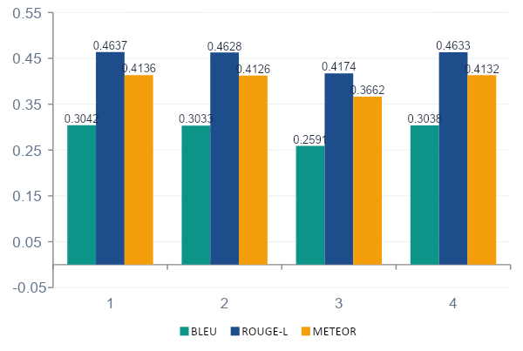
Model A — Testing & Evaluation Results
Test set performance across all models
Model | BLEU | ROUGE-L | METEOR
LR ★ | 0.3042 | 0.4637 | 0.4136
SVM | 0.3033 | 0.4628 | 0.4126
RF | 0.2591 | 0.4174 | 0.3662
Ensemble | 0.3038 | 0.4633 | 0.4132
★ LR outperforms on ALL metrics
Ensemble within 0.0004 BLEU of LR
RF excluded — lexical-only features limit ceiling
11 / 16
Mehdi (23i0048) | Fahad (23i0614)

Slide 12
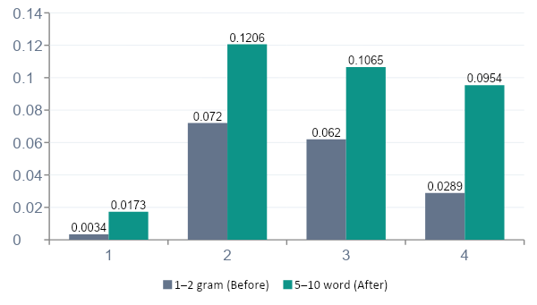
Model B — Testing & Evaluation Results
Distractor and hint generation metrics
Distractor Generation — Before vs After
BLEU
+5×
0.0034 → 0.0173
ROUGE-1
+67%
0.0720 → 0.1206
METEOR
+3.3×
0.0289 → 0.0954
Hint Generation: ROUGE-L 0.1375
12 / 16
Mehdi (23i0048) | Fahad (23i0614)

Slide 13
Performance Metrics & Interpretation
Understanding BLEU, ROUGE, METEOR
BLEU
Best: 0.3042 (LR)
ROUGE-1
Best: 0.4703 (LR)
Precision-oriented n-gram overlap. Best for short predicted text. Score 0.3 is strong for CPU-only classical model on RACE.
Unigram recall overlap. Captures how many reference words appear in prediction.
ROUGE-L
Best: 0.4637 (LR)
METEOR
Best: 0.4136 (LR)
Longest Common Subsequence. Rewards in-order word matches — more semantically sensitive than ROUGE-1.
Accounts for synonyms, stemming, and paraphrase. More linguistically robust than BLEU/ROUGE. Favours grammatically natural output.
13 / 16
Mehdi (23i0048) | Fahad (23i0614)

Slide 14
Streamlit Application — UI Overview
Four interactive screens
📄 Article Input
❓ Quiz View
• text_area for passage entry
• Load random RACE sample button
• Generate Quiz spinner
• Radio A/B/C/D options
• Check Answer + result display
• "Why?" keyword explainer
💡 Hint Panel
📊 Analytics Dashboard
• 3 graduated expanders (general → explicit)
• Reveal Answer after all 3 opened
• Session state guard
• Model A + B metrics tables
• Bar chart visualisations
• CSV export + session stats
14 / 16
Mehdi (23i0048) | Fahad (23i0614)

Slide 15
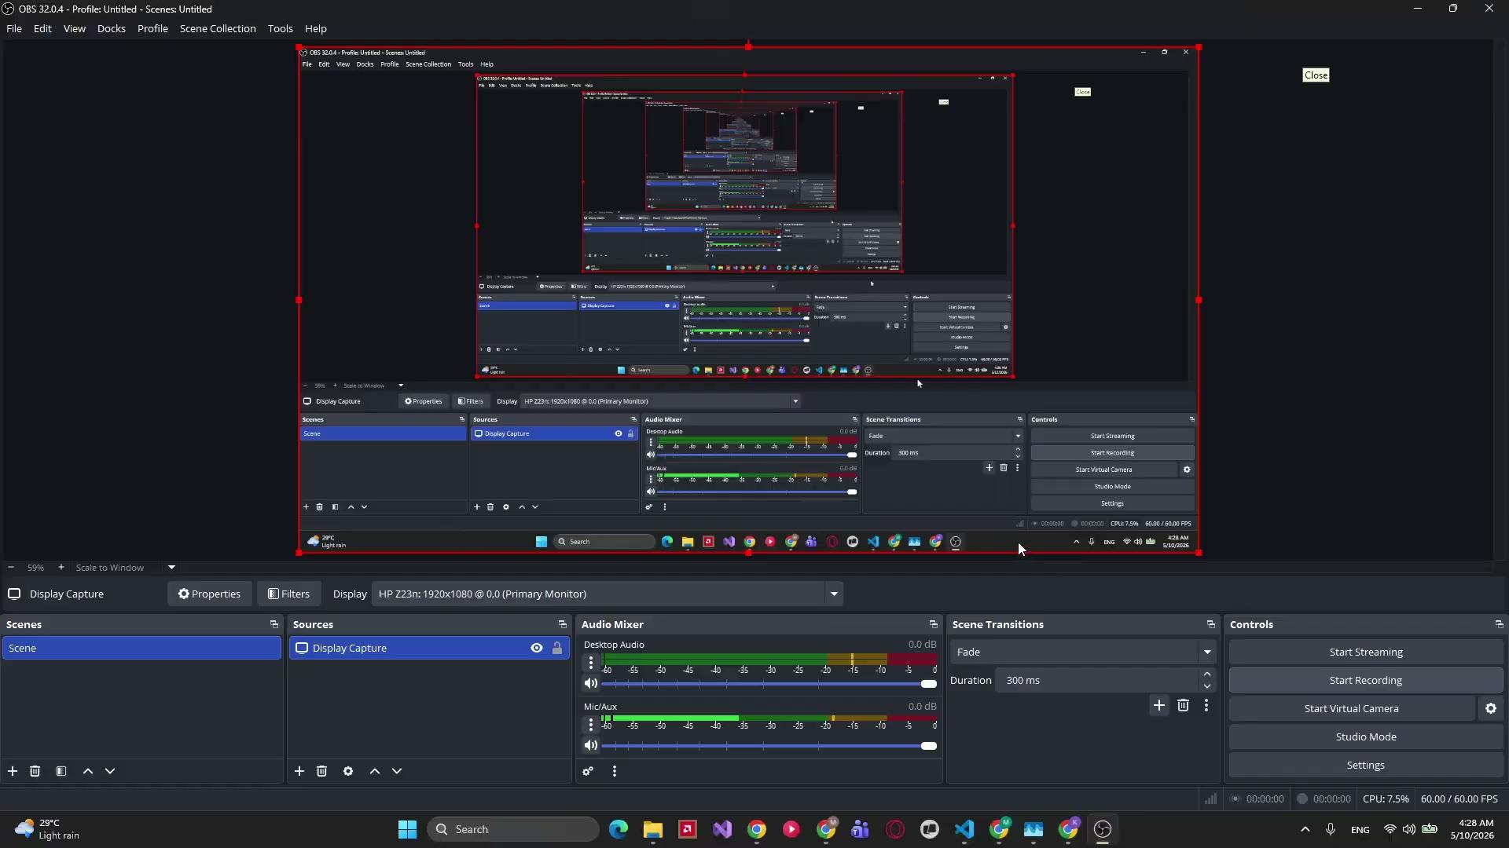
Live Project Demo
Demonstrating the Streamlit quiz generation system in action
▶
Screen recording of Streamlit app — quiz generation, answer checking, hint panel, and analytics
15 / 16

Slide 16
Conclusion & Key Takeaways
🏆 Logistic Regression: BLEU 0.3042, METEOR 0.4136 — best model on all metrics
⚡ Inference latency 0.3–1.5s on CPU — well within 10s requirement
📈 5–10 word sliding window improved distractor BLEU by 5× over 1–2 gram baseline
🎯 Hint generation: ROUGE-L 0.1375 (proxy target-sentence reference)
🖥️ Clean 4-screen Streamlit UI with analytics dashboard and CSV export
✅ All 7 unit tests pass; preprocessing symmetry ensures fair evaluation
16 / 16

